Slide 1



Lessons Learned
Simone Dalmasso, European Commission JRC
Paolo Pasquali, ITHACA

Slide 2
Background
Started working on GeoNode in 2010
Core developers since 2012
Projects: EC RDA, Masdap, UN WFP, Haitidata, Copernicus EMS Rapid Mapping, Harvard WorldMap

Slide 3
Outline
Concept
Issues
Case studies
Considerations
Conclusions

Slide 4


GeoNode Original Concept
“An SDI that makes uploading, sharing and working with data as easy as blogging”
Publishing spatial data
Metadata and reputation
Federated search
How?
Build bottom up
Align incentives
Be open
Non expert use
Source: Sebastian Benthall, Galen Evans “Spatial Data Infrastructure Best Practices with GeoNode”, 2010

Slide 5
Tools
Embed SDI in the real work of GIS practitioners, it will have more impact
How?
Give tools (styling, editing)
Build apps around APIs
Flexible Security
Features not policies
Source: Sebastian Benthall, Galen Evans “Spatial Data Infrastructure Best Practices with GeoNode”, 2010

Slide 6
Issues (una slide per ogni punto?)
Installation (apt-get, ansible, docker, VM…)
Hosting, Maintenance, load balancing
Data management (formats)
Metadata (INSPIRE?)
Customization
Upgrading + Migration

Slide 7
Installation, Maintenance, Upgrade
Installation and upgrade
Need a clean server
apt-get Ubuntu package: hard to maintain
Ansible: short lived
Docker: long term solution?
Data migration between major versions
Package versions
Hosting

Slide 8
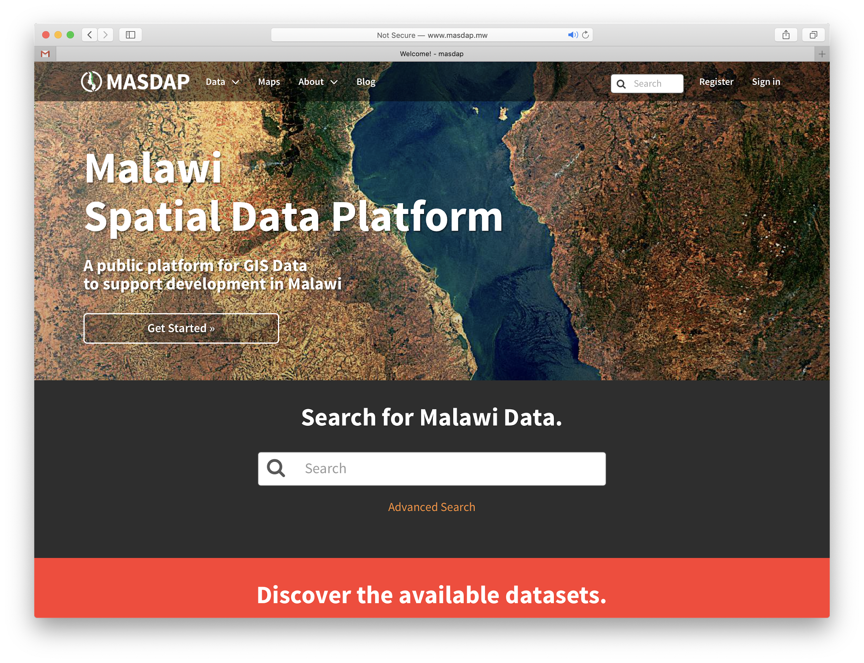
Case studies: Masdap
Funded by GFDRR First GeoNode in Africa (2012)
Pros:
Better share information
Capacity building
Community of ̴750 users
Cons:
Installation
Upgrading and data migration
Permissions (open data only)

Slide 9
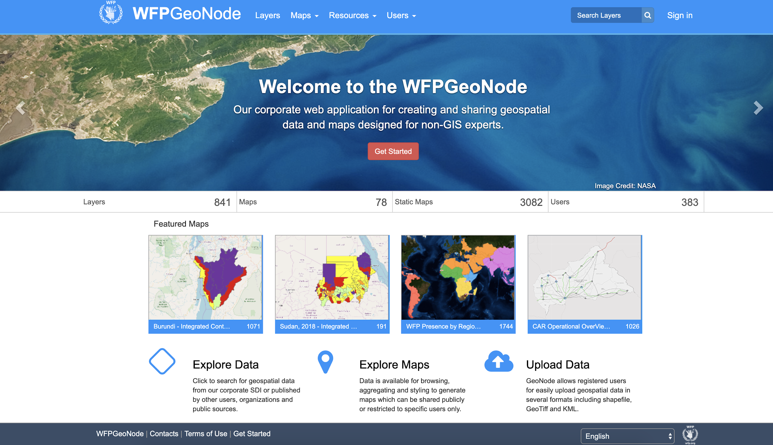
Case studies: WFP
Pros
To share spatial data with WFP offices around the world and with the public
Initially developed as data repository and interactive map builder
Then developed towards data hub for third party apps
Cons
Installation on docker + AWS not straightforward
Performance issues in particular on remote services

Slide 10
Case studies: Copernicus EMS
Installation -> had to be a core developer to make it working on CentOS
Security -> all Copernicus data are public, having such a fine grained security system was actually an overhead
Features -> Ultimate goal was to efficiently share and display spatial data and as the mapping client was outdated, the solution was to build our mapping client to consume the GeoNode APIs.
So -> GeoNode was used mostly as a backend engine to store, organise and categorise spatial data
Which was just great -> lot of features in the backend, out of the box
But -> We had to just share data that do not change over time...

Slide 11
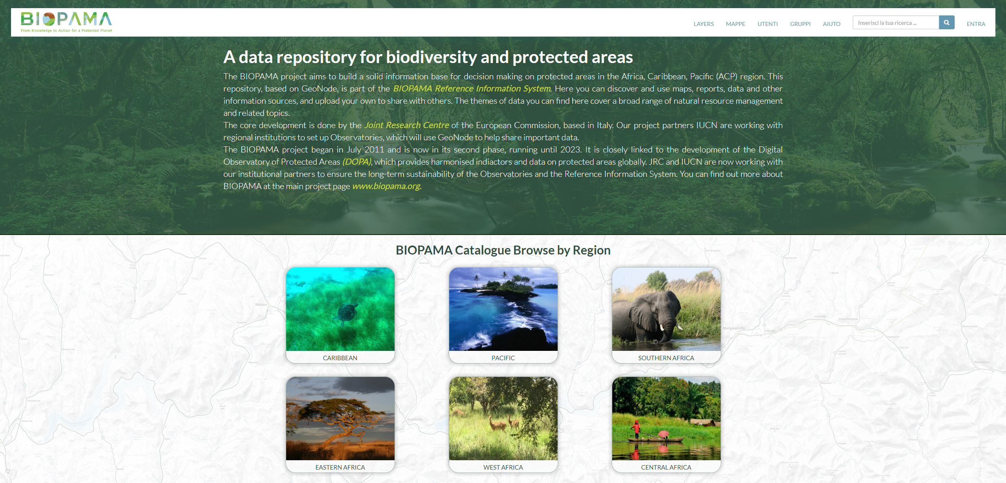
Case studies: Biopama, Peace and Stability
BIOPAMA
Pros:
Uploading geospatial data through a user friendly interface both Raster and Vector.
Style data on the fly.
Creating custom maps using the layers available on the system.
Performing queries on the fly over the layers.
Cons:
The installation/configuration process can be very hard on CentOs.
The documentation is not very robust.
Upgrading to a new version might be quite tricky.
PEACE AND STABILITY
Pros:
Lots of nice features out of the box
Nice permissions system
Cons:
The installation under reverse proxy is very tricky
The lockdown feature doesn’t really lock users data

Slide 12
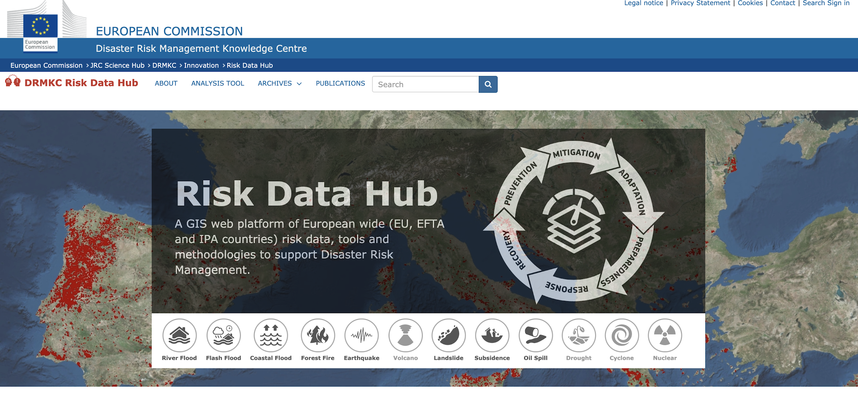
Case studies: Risk Data Hub
Pros:
Comprehensive content management system for spatial data
Good management of metadata
Extensible
Cons:
Hard to debug and upgrade: installation and configuration is a long and tricky process. Guides not clearly listed in one place. Docker doesn't work smoothly yet.
Does not keep the pace with releases of Django
Works only with custom version of GeoServer: it makes you work with a version which is not the most updated
Authentication on GeoServer via restRoleService: this causes privacy and security issues, as GeoNode publicly exposes all user names and roles
Geonode oAuth does not work with HTTP header security filters

Slide 13
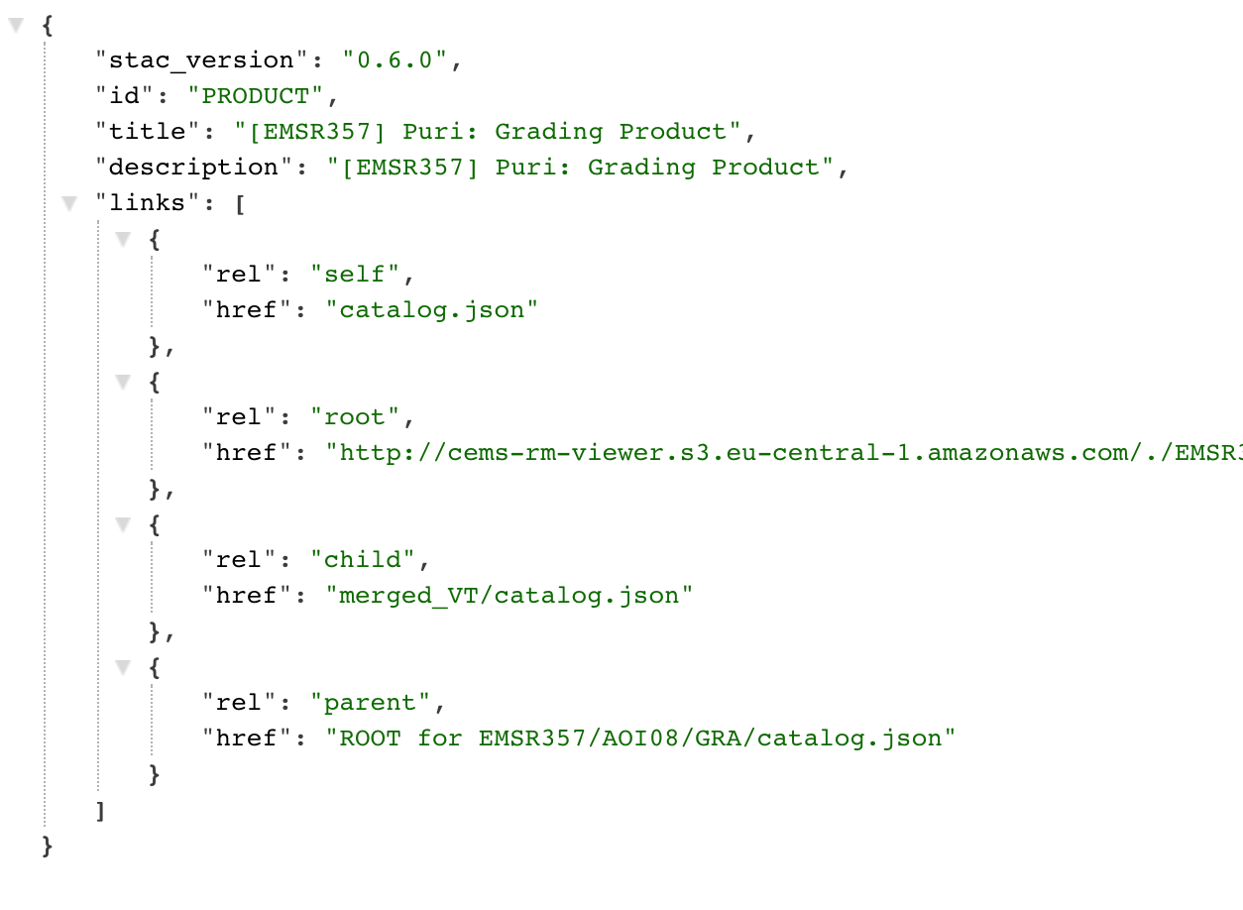
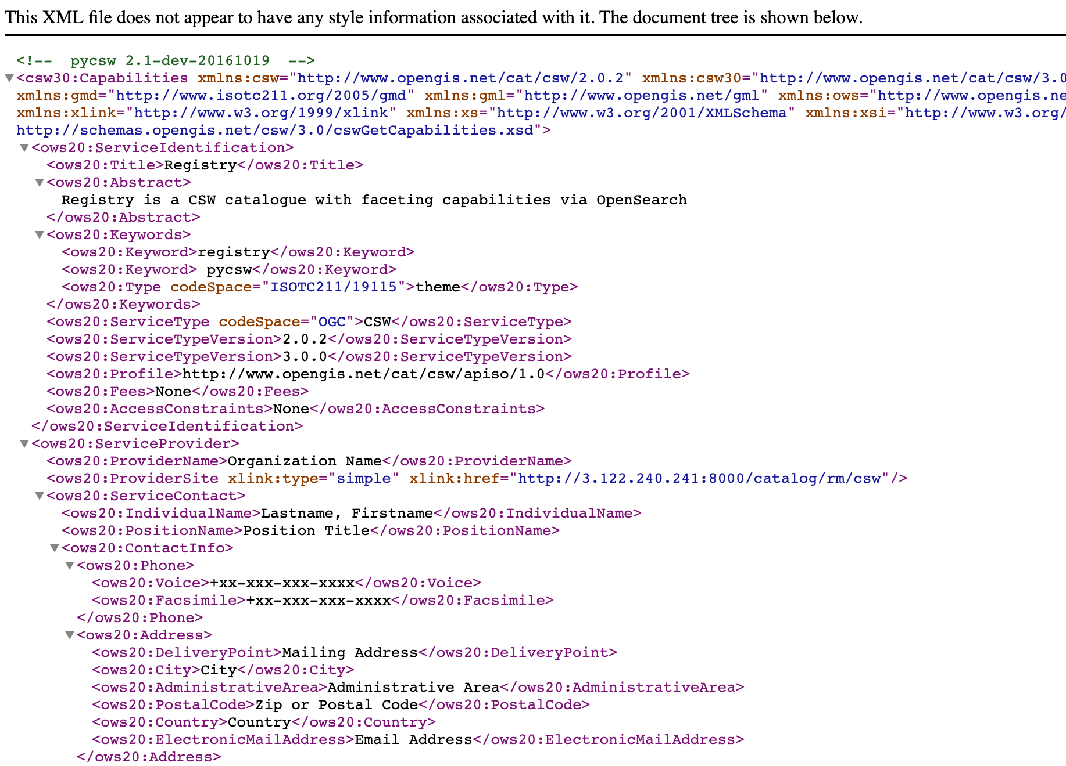
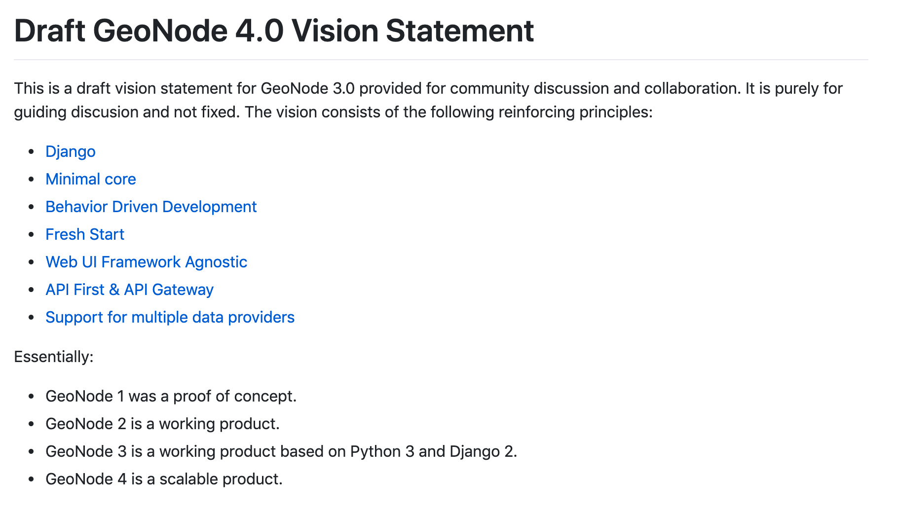
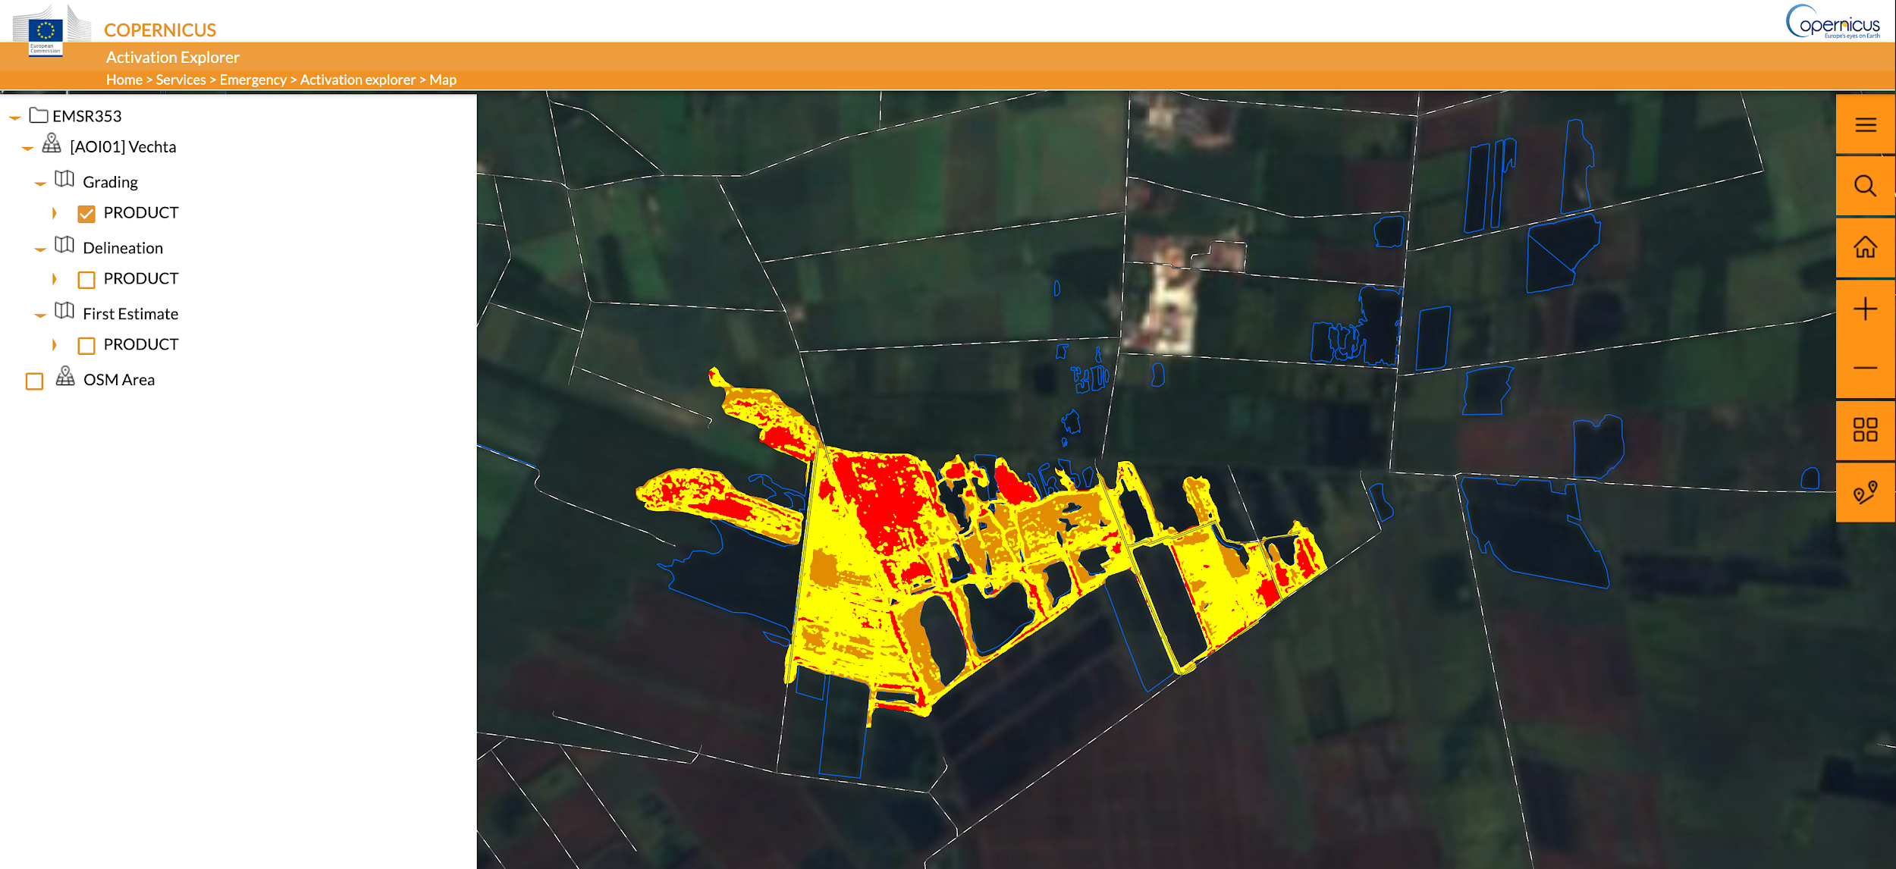
New developments AKA GeoNode 4+
https://github.com/GeoNode/geonode/issues/3228

Slide 14
GeoNode 4 considerations
A bottom - up approach in building a modular GeoNode 4 that provides
A rock solid data backend management with API (without database and mapping engine) + data upload as nice as it is now
A pluggable layer of logic for managing dynamic data (db and mapping engine, possibly with support of different backends)
A pluggable permissions system
A pluggable mapping clients
Any other modules (no “if ‘the_most_obscure_module’ in INSTALLED_APPS” anymore)
The website needs love, should be the place where to communicate properly all the excellent work done on GeoNode

Slide 15
Conclusions
ESRI is the way!!!

Slide 16
Conclusions
“
For all the returns already realized on GFDRR’s investment in GeoNode, the most important ones may still be in the future. GeoNode is today a flourishing open source project, with increasing uptake by organizations that will be able to support its continued maintenance and development independently of GFDRR. OpenDRI has contributed to the creation of a public good, but a public good of a very particular kind: GeoNode is both a software tool and a software project, and as a project it serves as a gathering place where inter-organizational cooperation can happen with a minimum of bureaucracy and with immediately tangible results.
Source: GFDRR, “OpenDRI & GeoNode: A Case Study for Institutional Investments in Open Source”, 2017

Slide 17
Customizations
The GeoNode project is always the preferred way to customize GeoNode:
Allows complete styles override
Complete modules/models override and overload
Extension to add third party apps
But it is not shipped with GeoNode out of the box
http://geonode.org/dev-workshop/

Slide 18
Conclusions
Thanks a lot to GeoSolutions and the contributors
for the big effort in the last years.

